Slide 1
Naïve Bayes Decision

Slide 2
Bayes Theorem
Bayes’ theorem is a way to figure out conditional probability. Conditional probability is the probability of an event happening, given that it has some relationship to one or more other events. . In a nutshell, it gives you the actual probability of an event given information about tests.
“Events” Are different from “tests.” For example, there is a test for liver disease, but that’s separate from the event of actually having liver disease.
Example: your probability of getting a parking space is connected to the time of day you park, where you park, and what conventions are going on at any time.

Slide 3
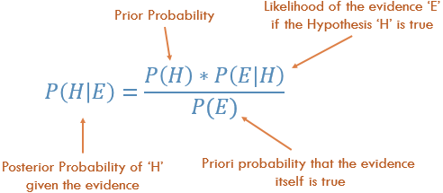
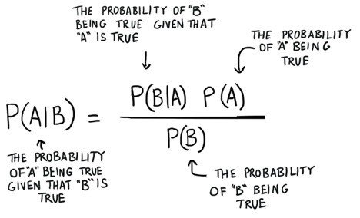
Formula

Slide 4
Bayes’ Theorem Example #1
You might be interested in finding out a patient’s probability of having liver disease if they are an alcoholic. “Being an alcoholic” is the test (kind of like a litmus test) for liver disease.
A could mean the event “Patient has liver disease.” Past data tells you that 10% of patients entering your clinic have liver disease. P(A) = 0.10.
B could mean the litmus test that “Patient is an alcoholic.” Five percent of the clinic’s patients are alcoholics. P(B) = 0.05.
You might also know that among those patients diagnosed with liver disease, 7% are alcoholics. This is your B|A: the probability that a patient is alcoholic, given that they have liver disease, is 7%.
Bayes’ theorem tells you: P(A|B) = (0.07 * 0.1)/0.05 = 0.14 In other words, if the patient is an alcoholic, their chances of having liver disease is 0.14 (14%). This is a large increase from the 10% suggested by past data. But it’s still unlikely that any particular patient has liver disease.

Slide 5
Bayes’ Theorem Example #2
Another way to look at the theorem is to say that one event follows another. Above I said “tests” and “events”, but it’s also legitimate to think of it as the “first event” that leads to the “second event.” There’s no one right way to do this: use the terminology that makes most sense to you.
In a particular pain clinic, 10% of patients are prescribed narcotic pain killers. Overall, five percent of the clinic’s patients are addicted to narcotics (including pain killers and illegal substances). Out of all the people prescribed pain pills, 8% are addicts. If a patient is an addict, what is the probability that they will be prescribed pain pills?
Step 1: Figure out what your event “A” is from the question. That information is in the italicized part of this particular question. The event that happens first (A) is being prescribed pain pills. That’s given as 10%.
Step 2: Figure out what your event “B” is from the question. That information is also in the italicized part of this particular question. Event B is being an addict. That’s given as 5%.
Step 3: Figure out what the probability of event B (Step 2) given event A (Step 1). In other words, find what (B|A) is. We want to know “Given that people are prescribed pain pills, what’s the probability they are an addict?” That is given in the question as 8%, or .8.
Step 4: Insert your answers from Steps 1, 2 and 3 into the formula and solve. P(A|B) = P(B|A) * P(A) / P(B) = (0.08 * 0.1)/0.05 = 0.16
The probability of an addict being prescribed pain pills is 0.16 (16%).

Slide 6
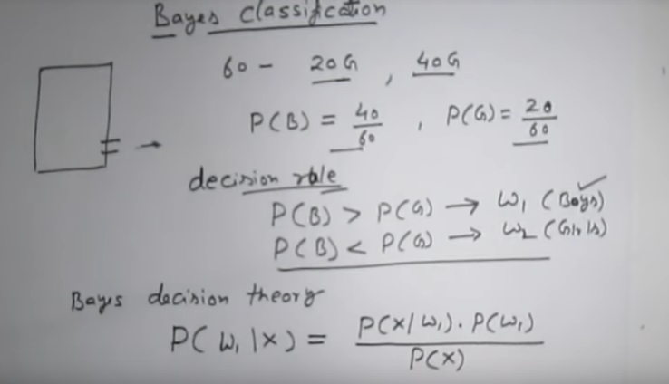
Bayes Classifiers
40 Boys

Slide 7
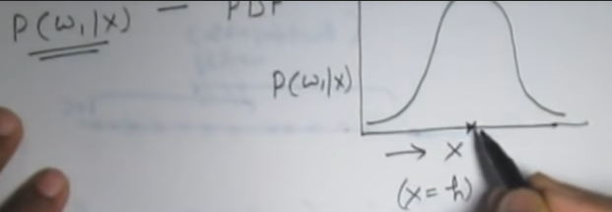
Probability Density Function

Slide 8

Example

Slide 9
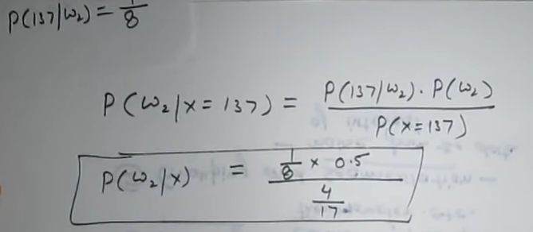
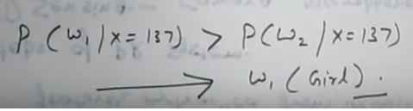
Example Continued

Slide 10
Naïve Bayes Decision
Naive Bayes is a simple, yet effective and commonly-used, machine learning classifier. It is a probabilistic classifier that makes classifications using the Maximum A Posteriori decision rule in a Bayesian setting.

Slide 11
Naïve Bayes Decision
The dataset is divided into two parts, namely, feature matrix and the response vector.
Feature matrix contains all the vectors(rows) of dataset in which each vector consists of the value of dependent features. In above dataset, features are ‘Outlook’, ‘Temperature’, ‘Humidity’ and ‘Windy’.
Response vector contains the value of class variable(prediction or output) for each row of feature matrix. In above dataset, the class variable name is ‘Play golf’.
Assumption:
The fundamental Naive Bayes assumption is that each feature makes an:
independent
equal
contribution to the outcome.
With relation to our dataset, this concept can be understood as:
We assume that no pair of features are dependent. For example, the temperature being ‘Hot’ has nothing to do with the humidity or the outlook being ‘Rainy’ has no effect on the winds. Hence, the features are assumed to be independent.
Secondly, each feature is given the same weight(or importance). For example, knowing only temperature and humidity alone can’t predict the outcome accurately. None of the attributes is irrelevant and assumed to be contributing equally to the outcome.

Slide 12
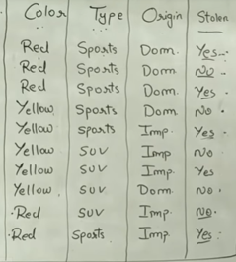

Slide 13
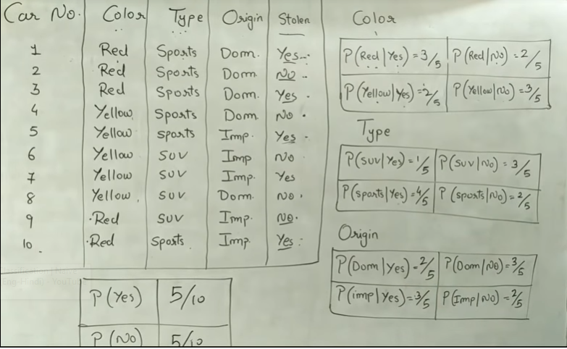
Example1

Slide 14
Example1 continued
p(x|yes) = p(Red|yes)*p(SUV|yes)*p(Dom|yes)
p(x)=p(Red)*p(SUV)*p(Dom)
P(yes|x)=(p(x|yes)*p(yes))/p(x)

Slide 15
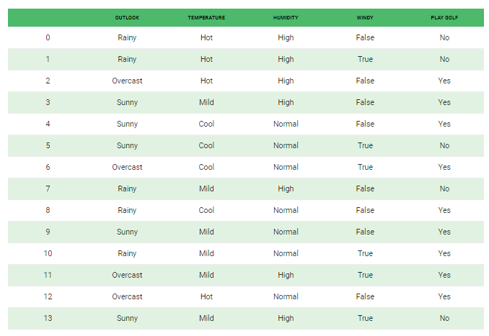
Example2

Slide 16
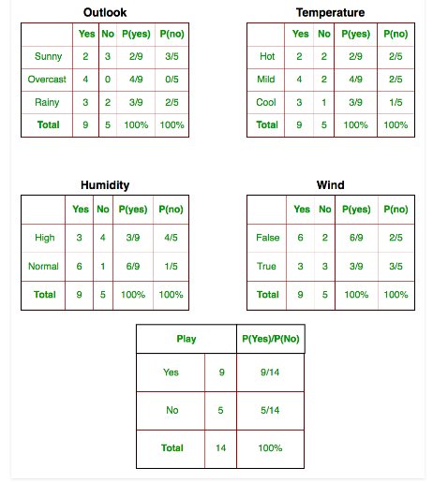
Example2 continued

Slide 17
Example2 continued
X=<Sunny, Cool, High, True>
P(yes|x)=(p(x|yes)*p(yes))/p(x)
p(x|yes) = p(Sunny|yes)*p(Cool|yes)*p(High|yes)*p(True|yes)
P(x) = p(Sunny)*p(Cool)*p(High)*p(True)

Slide 18
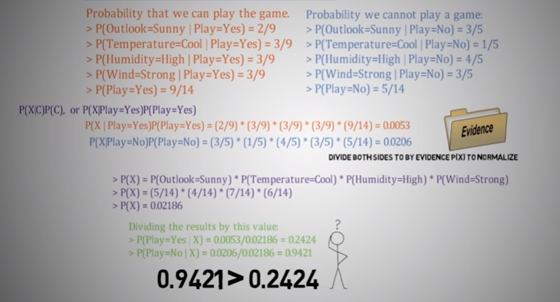
Example2 continued

Slide 19
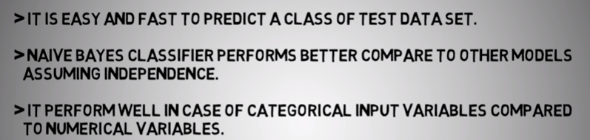
Pros

Slide 20
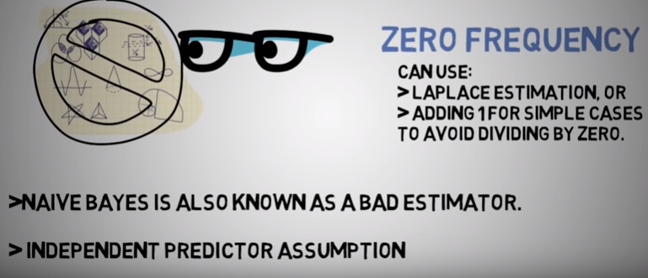
Cons

Slide 21

Applications

Slide 22
Reference
https://www.youtube.com/watch?v=CPqOCI0ahss&list=PLHmN7Pq-WTcz16J12PotUK-kDPF62VPSz&index=4
https://www.youtube.com/watch?v=TiRakVf0foU&list=PLHmN7Pq-WTcz16J12PotUK-kDPF62VPSz&index=2
https://www.youtube.com/watch?v=RixQygYyDKI&list=PLHmN7Pq-WTcz16J12PotUK-kDPF62VPSz&index=1

Slide 23
Thank You

